Slide 1
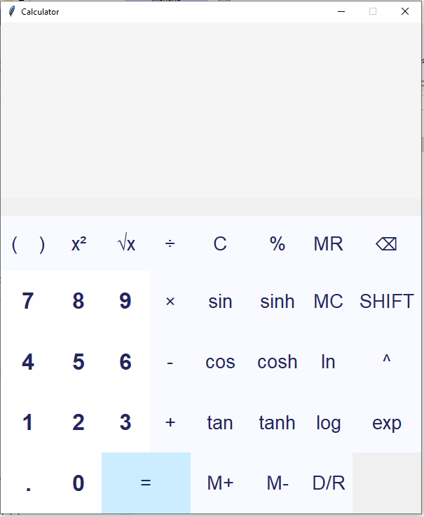
Calculator Application Project
Name: Chander Singh Digari
School: Grand Valley State University

Slide 2
Introduction
The calculator app supports basic arithmetic, scientific, and hyperbolic functions for complex calculations.
Users can switch between degree and radian modes for trigonometric operations, enhancing flexibility.
The app also offers memory functionality for storing and recalling calculation results, ensuring efficiency.

Slide 3
App Overview
The app handles basic arithmetic operations like addition, subtraction, multiplication, and division effectively.
Scientific calculations are supported with functions like sine, cosine, tangent, and their inverses.
Hyperbolic functions, such as sinh, cosh, and tanh, are also available for advanced mathematical work.

Slide 4
Technology Stack
Built with Python using Tkinter for the graphical user interface (GUI) and math library.
Designed to be compatible with Windows, macOS, and Linux for seamless cross-platform operation.
The app is optimized for performance, providing real-time calculations without noticeable lag.

Slide 5
User Interface Design
The user interface is designed to be intuitive, featuring clearly labeled buttons for all functions.
A simple layout ensures users can easily navigate between basic and advanced functions.

Slide 6
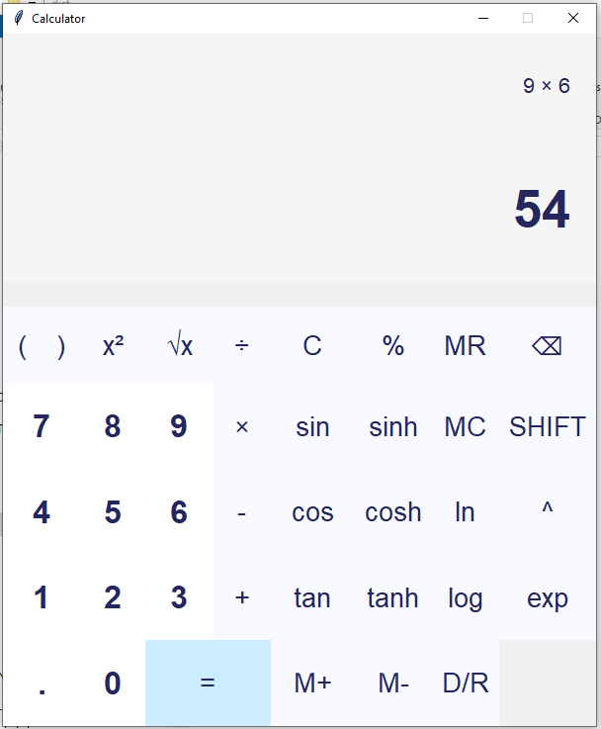
Functional Features: Basic Arithmetic
Basic arithmetic functions include addition, subtraction, multiplication, and division with real-time display of results.
Users can input and view calculations as they are entered, ensuring accurate result presentation.
The calculator shows results for basic operations after the user presses he equals button, ensuring quick and efficient calculations.

Slide 7
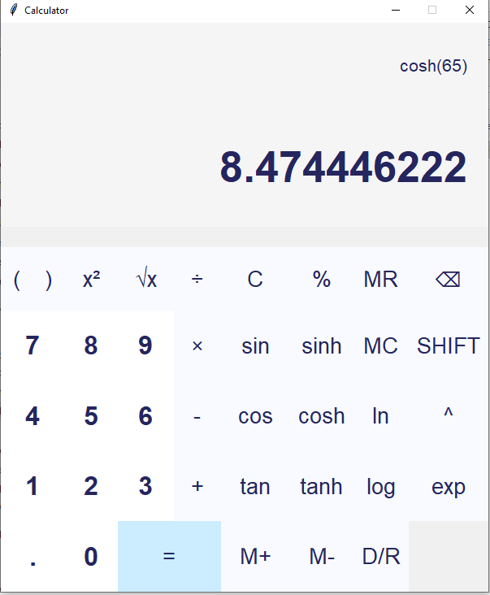
Functional Features: Scientific Functions
The calculator supports trigonometric functions like sine, cosine, and tangent for scientific calculations.
Inverse trigonometric functions become available when the shift mode is activated by the user.
The scientific functions enhance the calculator’s capability for advanced mathematical tasks and engineering problems.

Slide 8
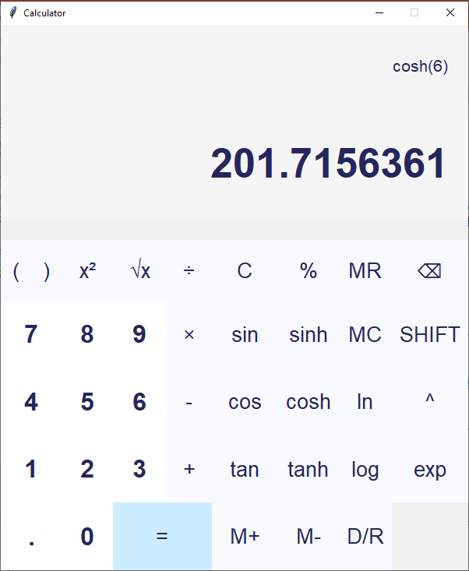
Functional Features: Hyperbolic Functions
Hyperbolic functions like sinh, cosh, and tanh provide additional options for solving advanced problems.
The calculator can handle both standard and hyperbolic functions to cover a wide range of needs.
Users can toggle between regular and hyperbolic functions with a shift button for flexibility.

Slide 9
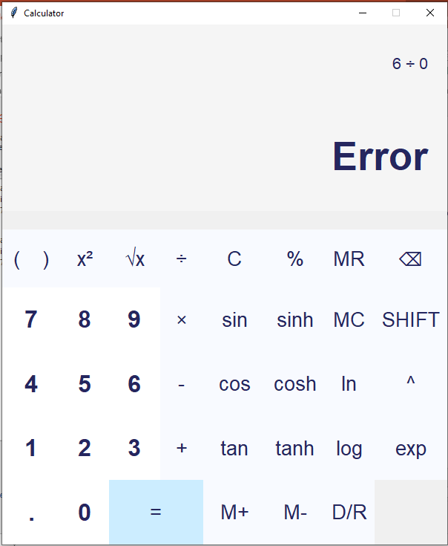
Error Handling
The calculator displays error messages when invalid input is entered, ensuring users are informed.
Overflow and undefined expressions are handled without causing the app to crash, enhancing stability.
The backspace function lets users delete the last character, allowing corrections to be made efficiently.

Slide 10
Memory Functions
The memory functionality allows users to store, recall, add, subtract, or clear stored values.
Memory management options like "M+", "M-", and "MC" help users manage complex calculations.
The calculator’s memory system allows users to perform calculations without losing intermediate results.

Slide 11
Input Methods and Compatibility
Supports keyboard input for all supported functions, offering convenience for power users.
Mouse input is also supported, allowing users to interact with the on-screen buttons directly.
Cross-platform compatibility ensures the calculator works seamlessly across Windows, macOS, and Linux environments.

Slide 12
Software Requirements
Functional Requirements: The app supports basic arithmetic, scientific functions, memory management, and error handling.
Non-Functional Requirements: The app should run with minimal lag, handle multiple calculations, and operate on various platforms.
Usability Requirements: The UI should be intuitive, responsive, and provide visual feedback to users during interactions.

Slide 13
Challenges and Solutions
The shift button is used to toggle between standard and inverse trigonometric functions efficiently.
Handling complex input parsing for mixed operations required careful design to prevent errors and crashes.
The app ensures stable memory usage and performance even with extensive scientific or hyperbolic operations.

Slide 14
Conclusion
The calculator app offers an intuitive, multi-functional interface for performing scientific and arithmetic calculations.
Future improvements could include graphing capabilities and additional advanced mathematical functions for wider use.
This project demonstrates the power of Python’s Tkinter library in creating interactive and efficient applications.

Slide 15
Thank You

